Slide 1
Machine Learning
Term Project Proposal
201433705 이진원
201433706 이하림
201533647 배태원
201835434 김주현

Slide 2
CONTENTS
01
02
03
04
Classification
Clustering
Schedule
Role

Slide 3
01
Classification

Slide 4
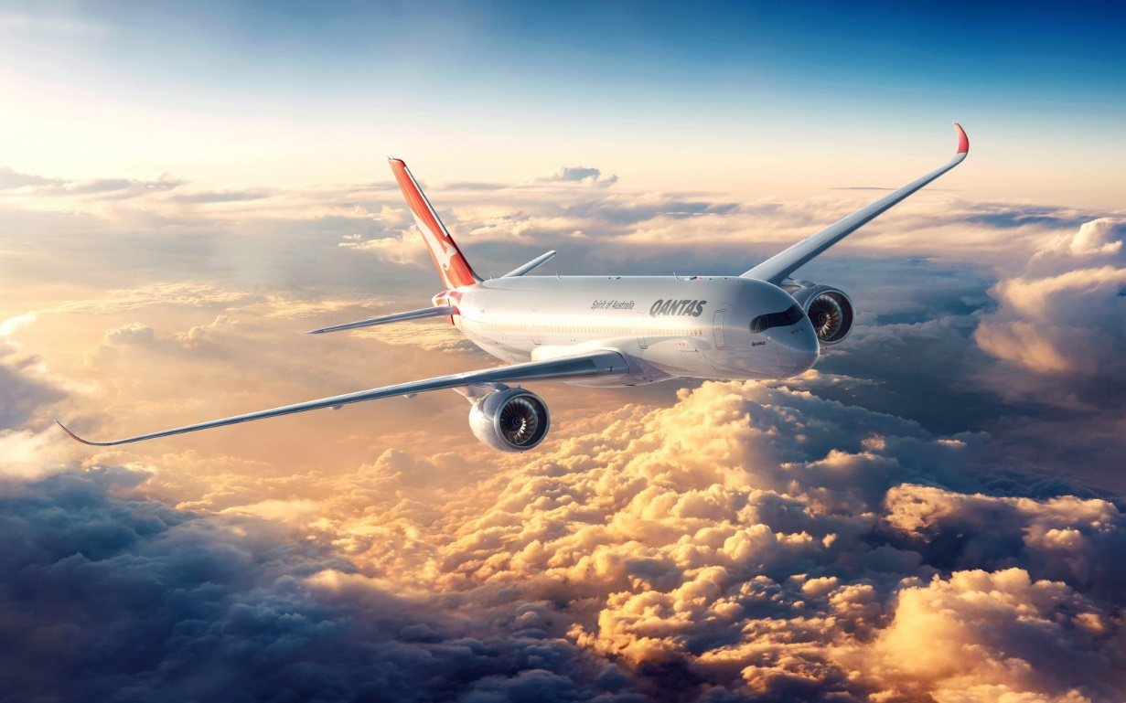
Introduction
1–1. Objective
Airline Passenger Satisfaction
Predicts whether the customer is satisfied with the flight or not, depending on the user's information, experience provided by the airline and/or service satisfaction.
Image source : https://www.airlineratings.com/news/safest-airlines-in-the-world-qantas-2020/
Notes:
The information of the user using the airplane and the questionnaire that the user responded to analyze whether the passenger was generally satisfied with the flight.

Slide 5
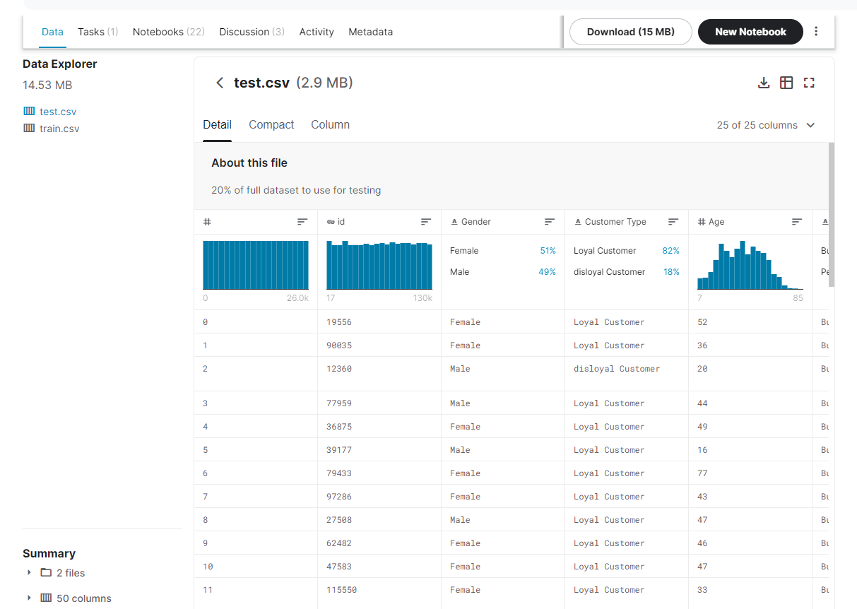
Introduction
1-2. Data Curation
▶ Kaggle
https://www.kaggle.com/teejmahal20/airline-passenger-satisfaction

Slide 6
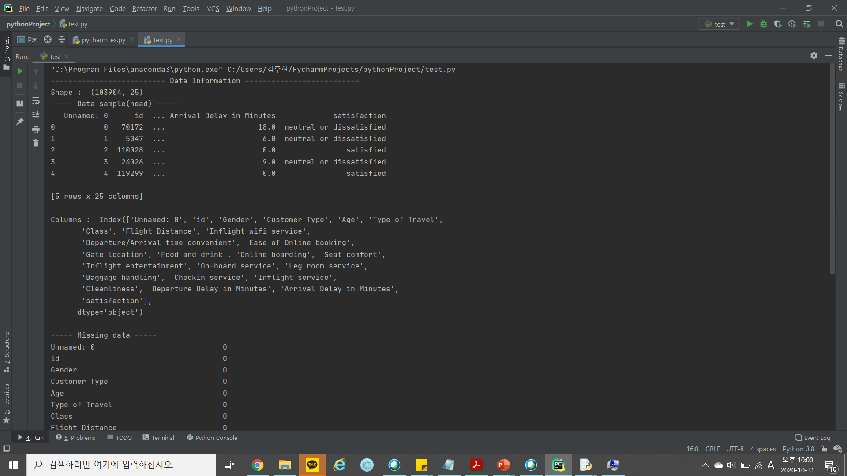
Introduction
1–3. Data Inspection
▶ Data Shape
▶ Data Category

Slide 7
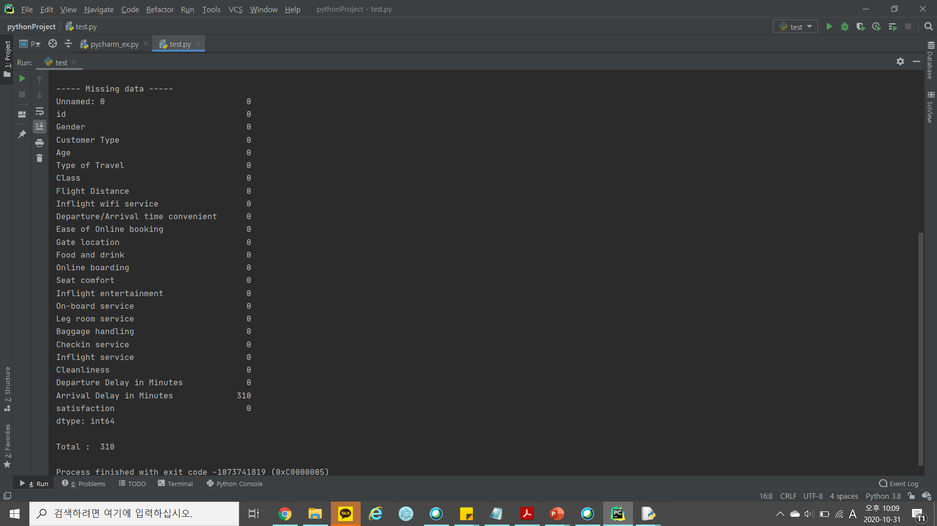
Introduction
1–3. Data Inspection
▶ Missing Value

Slide 8
Introduction
1–3. Data Inspection
▶ Detail Information of Columns
ID : Identification
Gender: Gender of the passengers (Female, Male)
Customer Type: The customer type (Loyal customer, disloyal customer)
Age: The actual age of the passengers
Type of Travel: Purpose of the flight of the passengers (Personal Travel, Business Travel)
Class: Travel class in the plane of the passengers (Business, Eco, Eco Plus)
Flight distance: The flight distance of this journey
Inflight wifi service: Satisfaction level of the inflight wifi service (0:Not Applicable;1-5)

Slide 9
Introduction
1–3. Data Inspection
▶ Detail Information of Columns
Departure/Arrival time convenient: Satisfaction level of Departure/Arrival time convenient
Ease of Online booking: Satisfaction level of online booking
Gate location: Satisfaction level of Gate location
Food and drink: Satisfaction level of Food and drink
Online boarding: Satisfaction level of online boarding
Seat comfort: Satisfaction level of Seat comfort
Inflight entertainment: Satisfaction level of inflight entertainment
On-board service: Satisfaction level of On-board service

Slide 10
Introduction
1–3. Data Inspection
▶ Detail Information of Columns
Leg room service: Satisfaction level of Leg room service
Baggage handling: Satisfaction level of baggage handling
Check-in service: Satisfaction level of Check-in service
Inflight service: Satisfaction level of inflight service
Cleanliness: Satisfaction level of Cleanliness
Departure Delay in Minutes: Minutes delayed when departure
Arrival Delay in Minutes: Minutes delayed when Arrival
Satisfaction (target): Airline satisfaction level(Satisfaction, neutral or dissatisfaction)

Slide 11
Data Processing
2-1. Data Preprocessing
Data Restructuring
Dropping the data that don't use ≫ ID
Preprocessing
- Missing / NaN data ≫ Drop
- Duplication deletion
- Delete Outlier
- Label encoding
- Scaling data
→ Min-Max scaler / Standard scaler / Robust scaler ≫ find best scaler by comparing accuracy
Notes:
주제 : GDP와 CO2 배출 간의 관계
알고리즘 : Kmeans, DB scan, EM

Slide 12

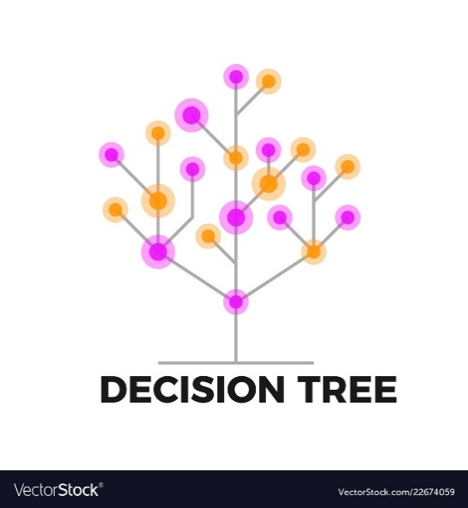

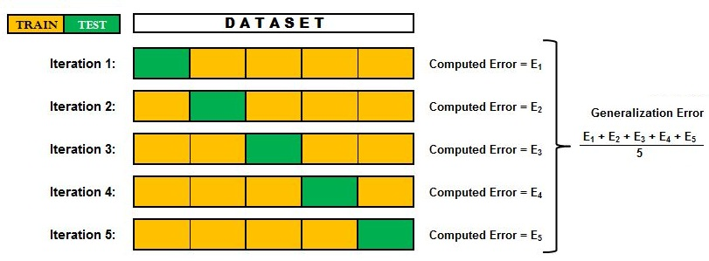
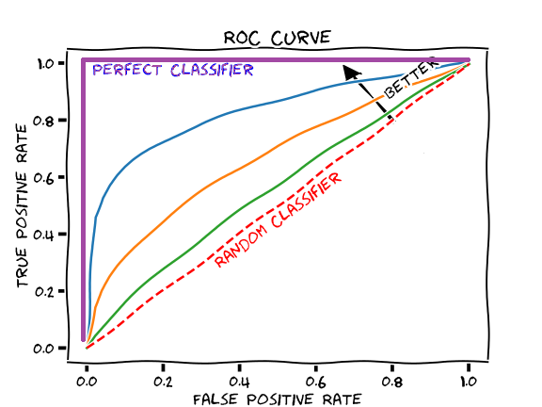
Data Processing
2-2. Data Analysis
Algorithm
Decision Tree Logistic Regression SVM
Evaluation
K-fold ROC - curve

Slide 13
02
Clustering

Slide 14



Introduction
1–1. Objective
Relationship between GDP and CO2 emissions
Finding the relationship between CO2 emissions per countries and GDP per countries by clustering
.
Notes:
The information of the user using the airplane and the questionnaire that the user responded to analyze whether the passenger was generally satisfied with the flight.

Slide 15
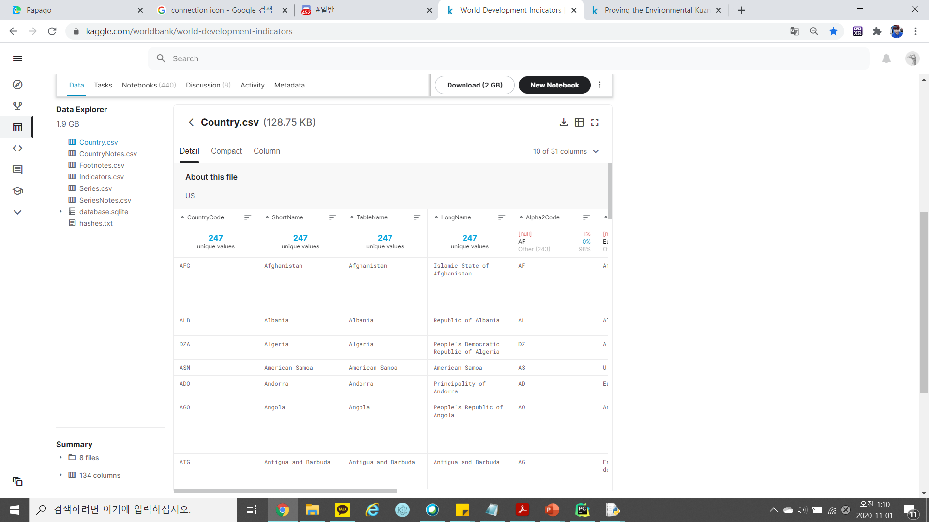
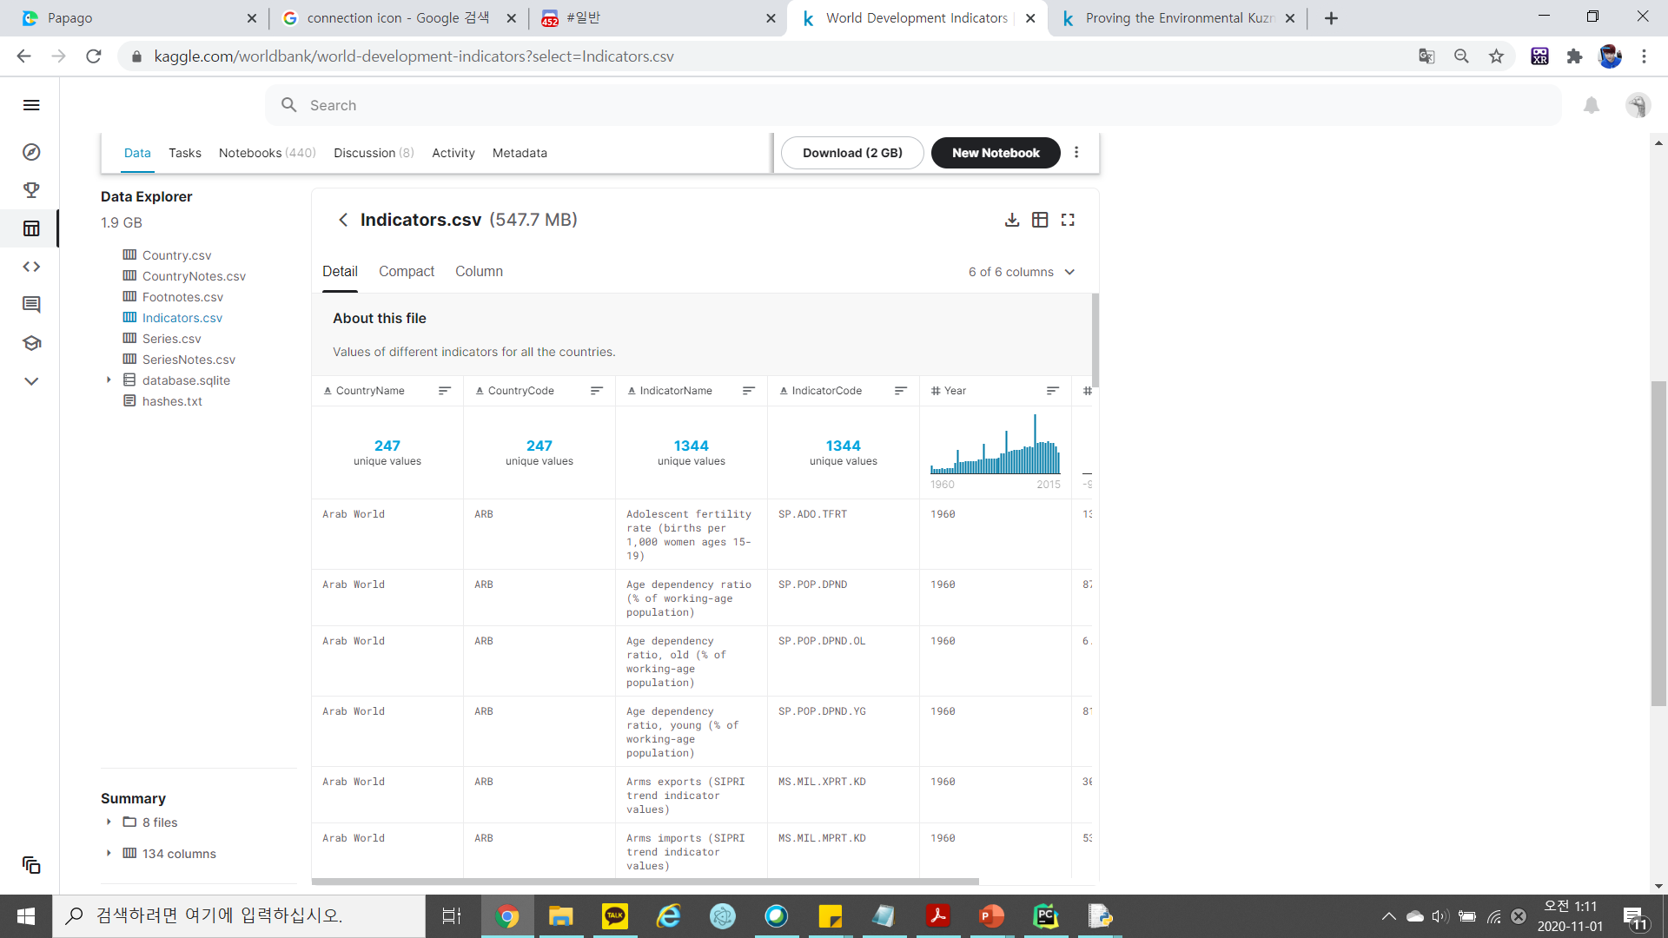
Introduction
1-2. Data Curation
▶ Kaggle
https://www.kaggle.com/worldbank/world-development-indicators

Slide 16
Data Processing
The indicator to use
- CO2 emissions (metric tons per capita)
- GDP per capita (constant 2005 US$)
Algorithm
- K-means
- DB scan (Density-based spatial clustering of applications with noise)
- EM (Expectation-maximization algorithm)
Evaluation
- Silhouette
- Elbow method
Notes:
주제 : GDP와 CO2 배출 간의 관계
알고리즘 : Kmeans, DB scan, EM
Evaluation : Kfold…?

Slide 17
03
Schedule

Slide 18
04.
Schedule
SUN | MON | TUE | WED | THR | FRI | SAT
11/1 | 2 | 3 | 4 | 5 | 6 | 7
8 | 9 | 10 | 11 | 12 | 13 | 14
15 | 16 | 17 | 18 | 19 | 20 | 21
22 | 23 | 24 | 25 | 26 | 27 | 28
29 | 30 | 12/1 | 2 | 3 | 4 | 5
Proposal
Presentation
Preprocessing
Classification
Clustering
Evaluation & Wise Prophet
Prepare Final Presentation
Final
Presentation

Slide 19
04
Role

Slide 20


03.
Role
201433705
이진원
201433706
이하림
201533647
배태원
201835434
김주현
Cleaning data, Data Preprocessing, Analysis, Evaluation

Slide 21
Thank you

